Slide 1
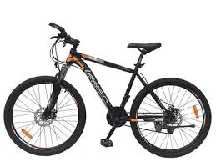
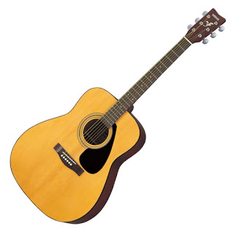
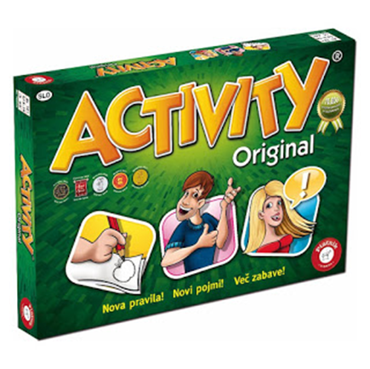
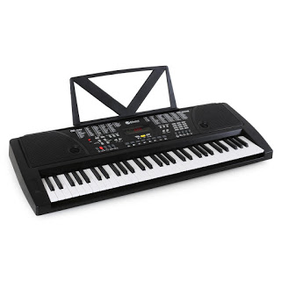
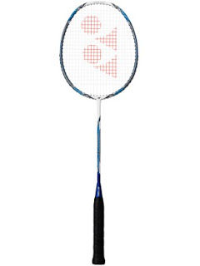
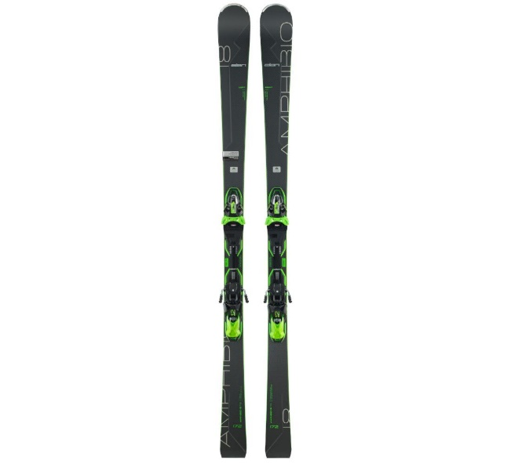
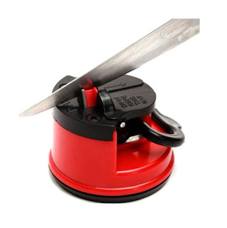
Catalog 2021
TEAM, LLC
CIRIUS Kamnik, high school
Novi trg 43 a
1241 Kamnik
Telephone: 01 830 13 25
E-mail: team.cirius@gmail.com

Slide 2
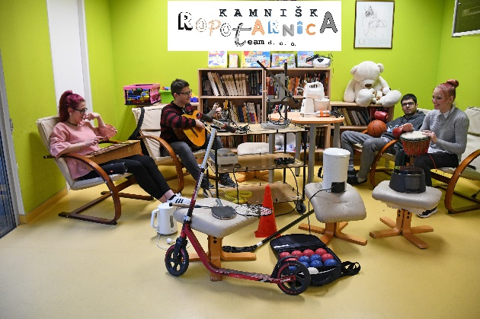
TEAM, LLC – team and responsibility
UP TEAM, LLC is engaged in renting second-hand items for everyday use, based on the principle of the „library of things“.
The items are rented directly (depending on current measures) and online.
Through our activity, we want our costumers to recognize us as a socially responsible company that allows people with different disabilities employment and integration, in the environment, while also responding to the environmental challenges of excessive consumption and promoting local coexistence.
Environmentally responsible SHARING of things for everyday use, while promoting a better quality of COEXISTENCE.

Slide 3
How does it all work?
You become a member of Kamnik‘s lumber room, when you pay a one-year membership fee of 40 € (students and pensioners: 15 €)
As a member, you can rent one item at a time free of charge, each additional rental costs 1 euro.
If you don‘t return the item on time, you will have to pay 2 euros for each missed day.
If an item is destroyed or lost, the member must replace it with a comparable item or (at least partially) compensate for the cost of the item, up to a half of the estimated value of the item.
All the items can also be rented without a membership fee. In that case, the rental fee will be charged depending on the item.
For an available time or anything else, contact us:
by telephone: 01 830 13 25 e-mail: team.cirius@gmail.com
THE OFFICE HOURS are from Monday to Friday from 8:00 to 13:00 (on Saturday and Sunday it‘s closed). By agreement, the pick-up of items is possible outside the office hours.
You can also find us online:
ONLINE CATALOG https://kamniskaropotarnica.blogspot.com/
FACEBOOK
https://www.facebook.com/ucno.podjetje.za.pravicno.in.trajnostno.ekonomijo
WELCOME

Slide 4
BOARD GAME ACTIVITY
BOARD GAMES
Article 1
Rental price for 3 days: 2,00 €
Rental price for 7 days: 4,00 €
A fun and diverse communication game for the whole family is a combinaton of different creative gaming elements. The player must present the concepts from the conceptual cards either by drawing, interpretation or pantomime, the teammates have to guess, which concept is at play.
A creative, communicative and always fun game!
It‘s suitable for people of the age of 12 and above. The number of players is from 3 to 16.

Slide 5
BOARD GAMEMONOPOLY
Article 2
Rental price for 3 days: 2,00 €
Rental price for 7 days: 4,00 €
Monopoly is an American board game for two to six players, where the players take on the role of landlords and, while moving through the marked fields, buy or sell them and invest in them by building houses and hotels.
The goal of the game is to take over the majority of the fields and force others into bankrupcy by investing.

Slide 6
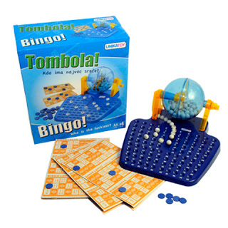
BOARD GAME BINGO
Article 3
Rental price for 3 days: 2,00 €
Rental price for 7 days: 4,00 €
The dynamic board game Bingo is designed for two or more players. The one who fills two horizontal lines or one column on the board, wins.

Slide 7
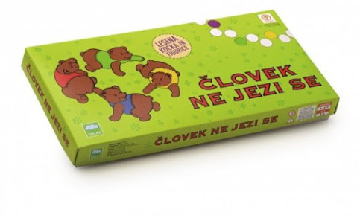
BOARD GAME LUDO
Article 4
Rental price for 3 days: 2,00 €
Rental price for 7 days: 4,00 €
A fun board game for two to four players, in which the one, who brings all their pieces into the marked boxes, wins.

Slide 8
ACOUSTIC GUITAR D-175
MUSIC
Article 5
Rental price for 3 days: 8,00 €
Rental price for 7 days: 15,00 €
Flight D-175NA, acoustic guitar D-175 represents an instrument, that offers each guitarist all the characteristics we expected and looked for in the instrument.
It‘s suitable for beginners and those with more guitar skills! Because of its construction and shape, it offers a dynamic and loud sound, which is very important for an acoustic instrument.

Slide 9
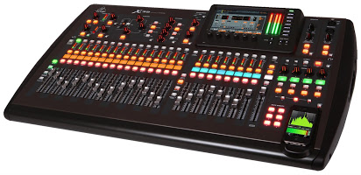
MIXING TABLE
Article 6
Rental price for 3 days: 15,00 €
Rental price for 7 days: 25,00 €
The mixing table allows a variety of inputs and outputs, control of volume, signal indication and sending an audio signal to a technician. Its basic functions are signal processing, which means preamplification, level adjustment, adding effects, and frequency control.

Slide 10
ELECTRIC KEYBOARD
Article 7
Rental price for 3 days: 15,00 €
Rental price for 7 days: 25,00 €
The Yamaha electric keyboard EZ-220 is an excellent keyboard for practise. It‘s equipped with a keyboard, which has 61 illuminated and touch-sensitive keys (five octaves).
You can wirelessly connect it with Page Turner, a free app for iPad, and 100 preset songs with digital notation. Due to these abilities, it is suitable for beginners.
The keyboard already has 100 recorded tracks for learning with light effects.

Slide 11
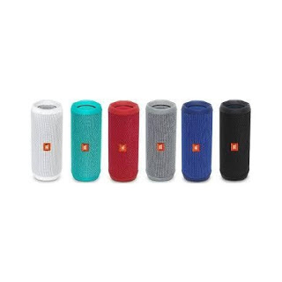
SPEAKERS JBL FLIP 4
Article 8
Rental price for 3 days: 5,00 €
Rental price for 7 days: 8,00 €
JBL Flip 4 is the newest generation of reputable portable Bluetooth speakers that brings a bunch of novelties and will excite even the most demanding users! The compact device is powered by a rechargeable 3000 mAh battery, which offers up to 12 hours of continuous use. Unlike its predecessor, it is waterproof, with the IPX7 certificate, which means it will work even if it falls in water and stays there for up to 30 minutes. It also has built-in noise and echo removing functions for a crystal clear sound when having phone conversations.

Slide 12
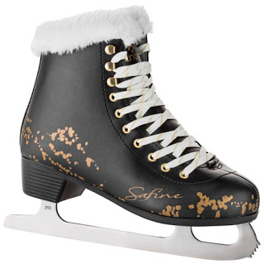
SKATES
SPORTS
Article 9
Rental price for 3 days: 5,00 €
Rental price for 7 days: 8,00 €
Women’s lined skates, sizes 37 to 41. Suitable for beginners and more experienced skaters – we take care of the grinding.

Slide 13
BYCICLE
Article 10
Rental price for 3 days: 15,00 €
Rental price for 7 days: 25,00 €
A mountain bike with 29” wheels that provide carefree riding on all terrains, because they level uneven ground and dampen vibrations very well. Larger wheels also mean it’s easier to ride, so the bike works perfectly for both ascending and descending, where the front suspension will be even more helpful.

Slide 14
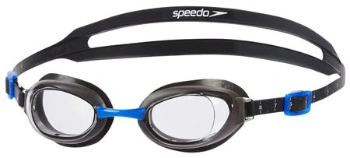
SWIMMING GOGGLES
Article 11
Rental price for 3 days: 2,00 €
Rental price for 7 days: 4,00 €
We offer professional Speedo swimming goggles that protect the eyes from the water and allow a clear view even below the surface.

Slide 15
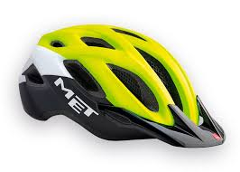
CYCLING HELMET
Article 12
Rental price for 3 days: 2,00 €
Rental price for 7 days: 4,00 €
The MET helmet is designed for all mountain bikers, who need a high level of airing during peak conquering and while subordinating challenging descents, a high level of protection against hits. With the In-Mold helmet construction and EPS foam, it guarantees an elevated durability, helmet stability and vibration alleviation. With increased coverage on key areas of the head, additional safety is provided without increasing the weight itself.

Slide 16
BADMINTON RACKETS
Article 13
Rental price for 3 days: 2,00 €
Rental price for 7 days: 4,00 €
The racket is approximately 66 cm in length, in a shuttlecock made of cork (diameter 2,6–2,8 cm, weight 4,7–5,5 g) a plastic skirt of 7 cm in length, is stuck.

Slide 17
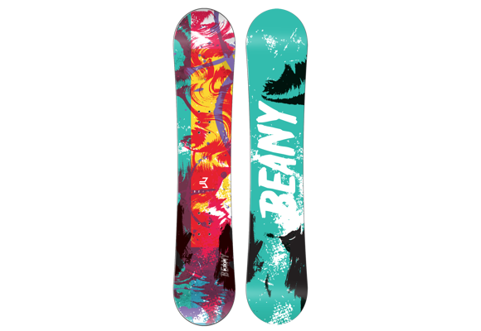
SNOWBOARD
Article 14
Rental price for 3 days: 8,00 €
Rental price for 7 days: 12,00 €
The Carbon Gold Split snowboard will excite even the more experienced users. It has a strong wooden core, Ima močno leseno jedro.
Types: Allmountain/Freeride, profile: Fullrocker, flex: Medium-Stiff, lamination: Triax/carbon, shape: Directional twin, center: graphite.
For advanced boarders it’s made of a wooden core, surrounded by a Triax/carbon layer.

Slide 18
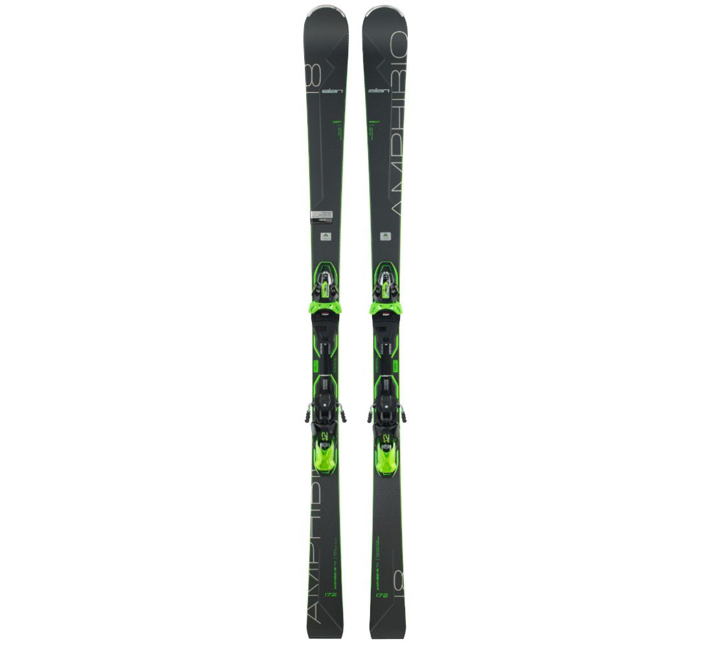
ALPINE SKIS
Article 15
Rental price for 3 days: 20,00 €
Rental price for 7 days: 30,00 €
Queen of carving. Amphibio 18 TI2 is bursting from strength and precision and proudly wears its crown when it comes to fast transmissions from curb to curb, stability and cutting turns.

Slide 19
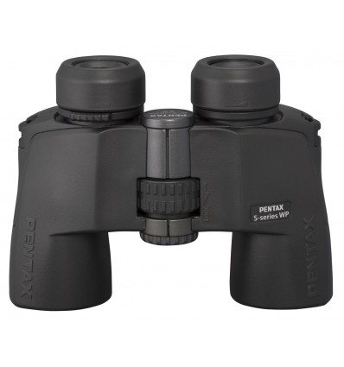
BINOCULARS
Article 16
Rental price for 3 days: 5,00 €
Rental price for 7 days: 8,00 €
The Pentax SP 8X40 WP binoculars are an excellent representative of their class. In a powerful and relatively light metal bag, which has a multi-layered illumination and a hydrophobic coating on the lenses, efficient seals and nitrogen filling, are eight parts. In our opinion, these are the best binoculars for a tourist or hunter – they regulate their tasks in rain and snow, survive falls and swims at the depths of up to a meter. And with all that, they have bright optics, which work well in dusk and a very low distortion rate. The casing is made of rubber, so it doesn’t freeze the hand of the user and it fits much more into it.

Slide 20
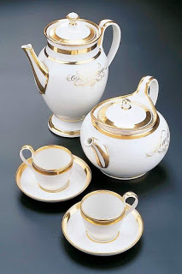
TEA SERVICE
HOUSEHOLD
Article 17
Rental price for 3 days: 5,00 €
Rental price for 7 days: 8,00 €
Suitable for use in microwave ovens and dishwashers. Enjoy your favorite drink. Warm tea will warm you up on cold winter evenings.

Slide 21
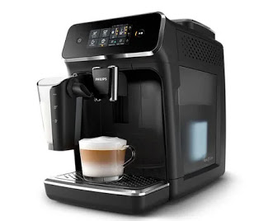
COFFEE MACHINE
Article 18
Rental price for 3 days: 10,00 €
Rental price for 7 days: 15,00 €
The machine automatically puts paper cups, spoons and sugar. Therefore, it does not need extra surfaces for sugar or pots. Due to the small size of the appliance, it is possible to place on the surface 80x80 cm.

Slide 22
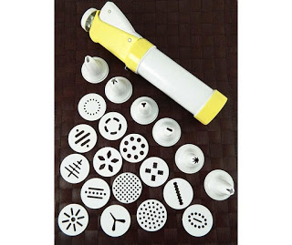
SET FOR DECORATING DESSERTS AND MAKING BISCUITS
Article 19
Rental price for 3 days: 2,00 €
Rental price for 7 days: 4,00 €
Set of decorating attachments – decorating and making biscuits.
The set contains 20 pieces: - 6x different decorating attachments - 14x cookie-making attachments

Slide 23
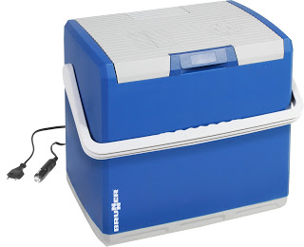
COOLING BAG
Article 20
Rental price for 3 days: 5,00 €
Rental price for 7 days: 8,00 €
A portable electric cooling bag with a capacity of 32 l is a great solution for those who go camping, picnics or other activities in the summer and want to have a cold drink at your fingertips. It is distinguished by a special thermal insulation function of cooling and heating, which allows a constant temperature to be sustained up to 20 °C below the ambient temperature. It is distinguished by folding ergonomic handles, which are so positioned that you can hide them in the lid and handy locks to lock the lid.

Slide 24
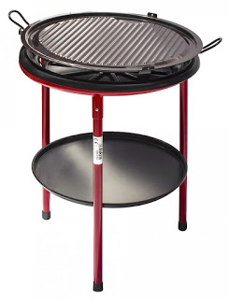
OUTDOOR GRILL
Article 21
Rental price for 3 days: 8,00 €
Rental price for 7 days: 12,00 €
All-in-one: grilling and/or smoking. Quality grill: stainless with good heat storage. Cooking with a smoked character: the smoke rises from a small smoking area.

Slide 25
KNIFE GRINDER
Article 22
Rental price for 3 days: 2,00 €
Rental price for 7 days: 4,00 €
Knife grinders are extremely effective and safe to use.
They are suitable for grinding all types of knives: kitchen, butcher, hunting and pocket knives, whether with smooth or jagged blades.

