Slide 1
Economy and Trade school
Prijepolje, Serbia
USB TEAM
Production and trade of male and female fashion items and cosmetic products
CONNECT!

Slide 2
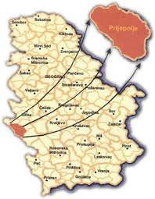
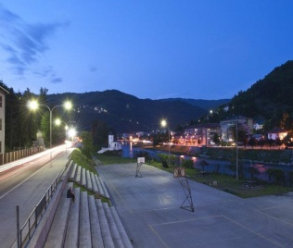
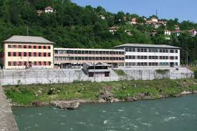
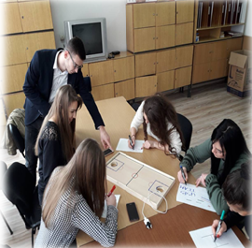
WHO WE ARE?
Student company "USB team" is formed on December 19, 2017. in the
Economic and Trade School located in
Southeast Europe, in country Serbia, Prijepolje.
The purpose of the company is
to bring together a fresh inspiration.

Slide 3
HOW DID WE GET THIS IDEA?
We were thinking about what we could offer on the market, while attracting the attention of customers and achieving our common interests.
We looked at people around us, we talked with friends, we watched personal interests.

Slide 4
MISSION AND VISION
Mission of our company is that our originality attracts people with the finest tastes to find what suits them the best.
The vision of our company is the product which was created andplaced on the market.

Slide 5
GOALS
There is no harm in repeating a good thing.
Increase in sales
Improving promotional activities of the company
Improvement of distribution
Sales improvement
Training of professional staff
Strengthening the leadership position
Creating a positive image and a strong brand

Slide 7
Marketing strategy is reflected in the fact that we promote our products on the market, through our social pages, as well as printing catalogs and brochures, then we distribute our products through local and regional distributors.
Usb team
@usbteam
usbtam2000@gmail.com
usbteam2000.wixsite.com/website

Slide 8
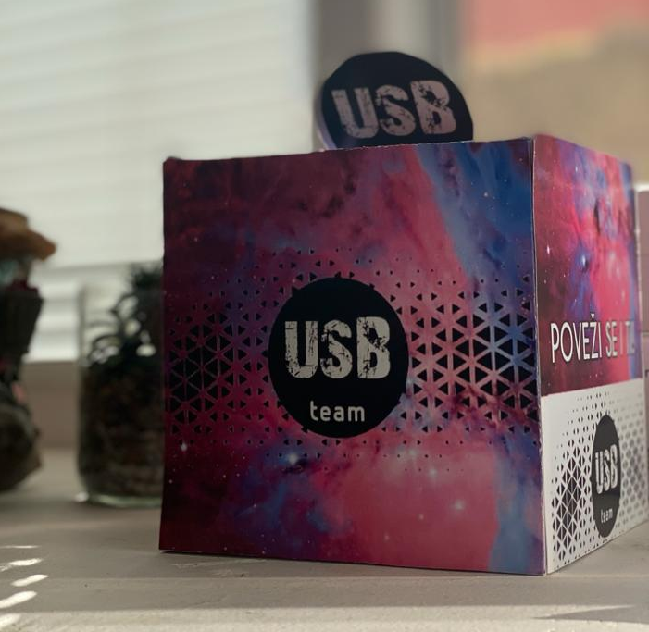
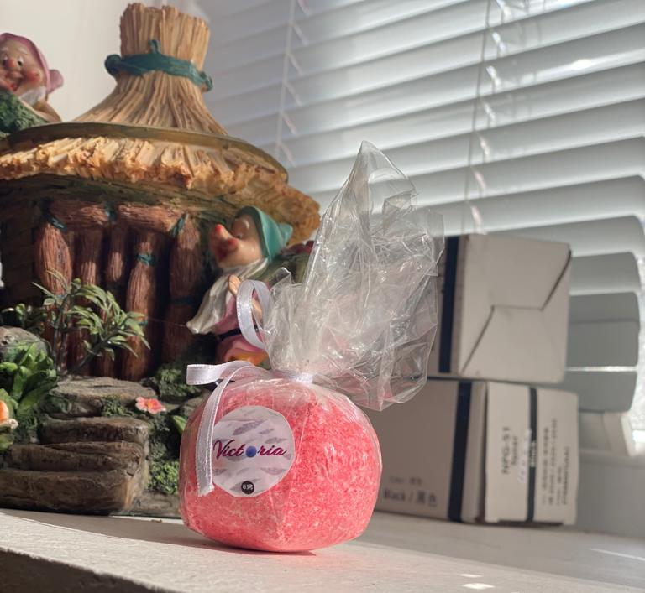
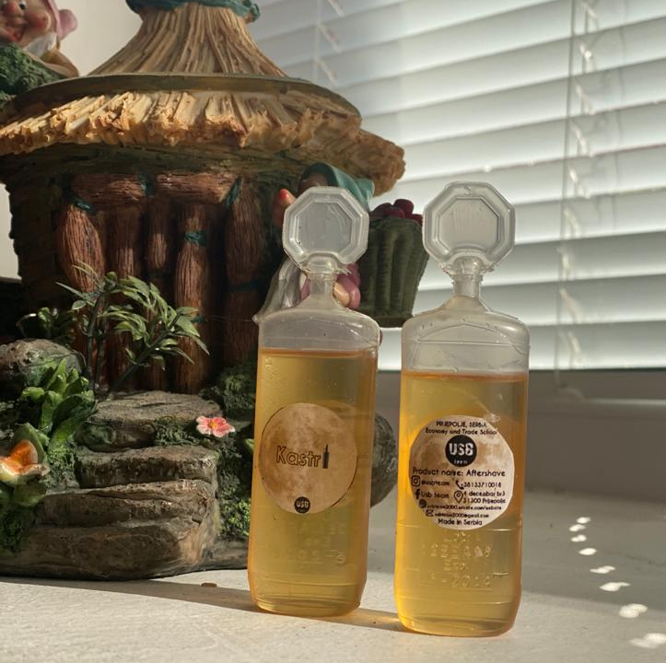
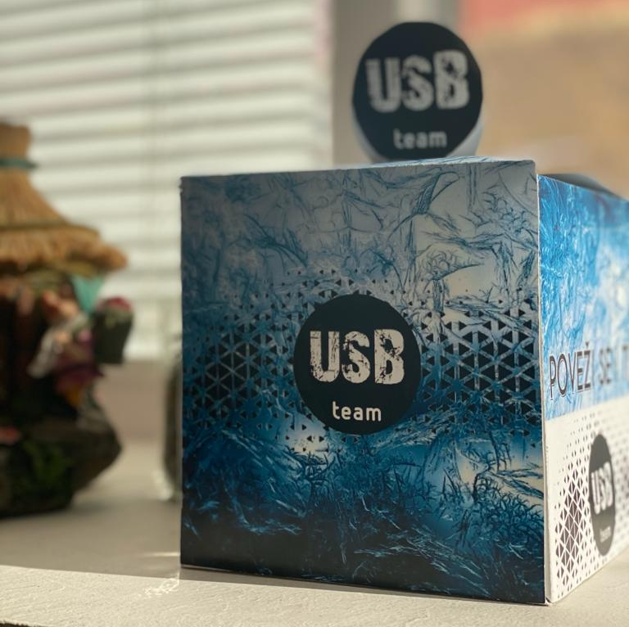
ASSORTMENT
TOP PRODUCTS
Women’s
gift box
Victoria
bath bomb
Man’s
gift box
Kasteri

Slide 9
STRUCTURE OF EMPLOYEES
Marketnig
Production
6
Finance
General director
12
5
9

Slide 10
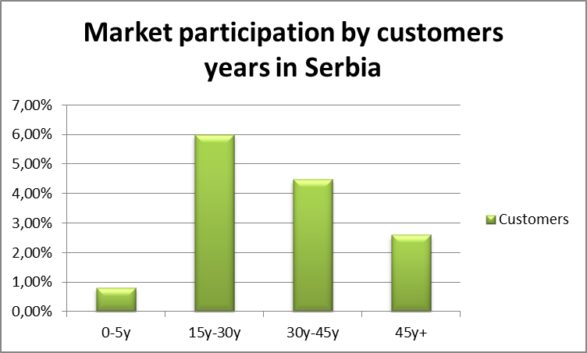
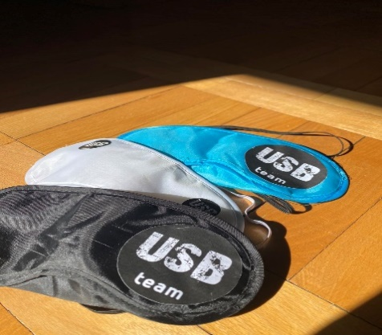
FINANCE
POINT COVERAGE
T
Q=$\frac{\sum{FT}}{pt−vt}$
avail
Q=$\frac{10000}{1.50−0,70}$
10000
loss
FT
Q=12500
12500
Q
For all the financial details you can contact our finance manager.

Slide 11
CONNECT!
Thank You!

