Slide 1
ADRIATIC PLC.
ZAGREB- CROATIA

Slide 2
ABOUT US

Slide 3
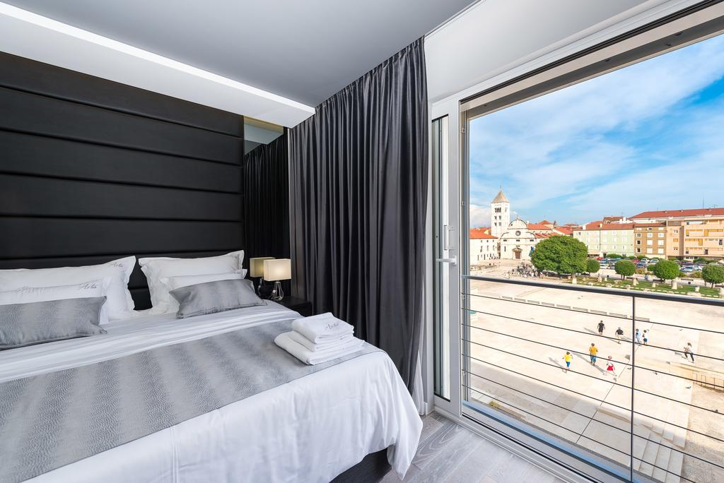
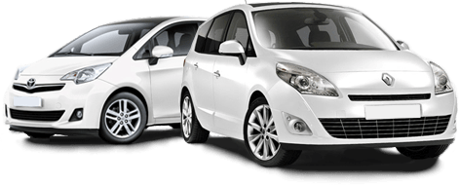
SERVICES WE OFFER

Slide 4
TRAVELS WE OFFER

Slide 5
TRANSPORT
TRANSPORT
CAR
Joint transport
A cab
Rental car
AIRPLANE
RAILWAY
railway
international
domestic

Slide 6
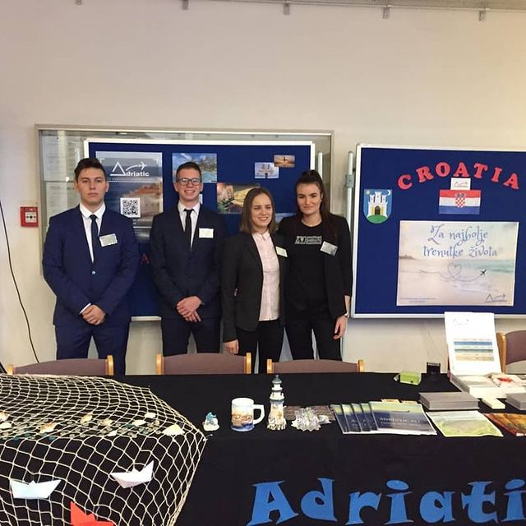
OUR TEAM
4 DEPARTMENTS

Slide 7
1. IT DEPARTMENT- GABRIEL BELOŠA

Slide 8
2. SALE DEPARTMENT- JURKOVIĆ DORA

Slide 9
3. MANAGMENT- GREGORAŠ NIKA

Slide 10
4. HUMAN RESOURCES- KUDELIĆ LUKA

Slide 11
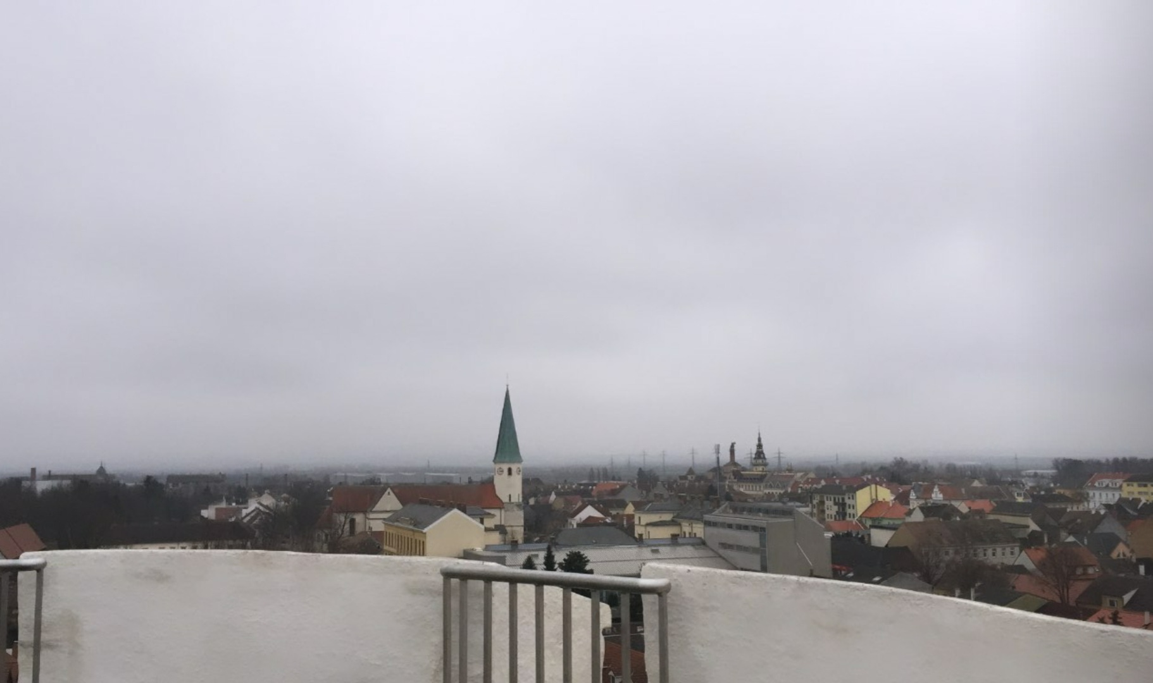
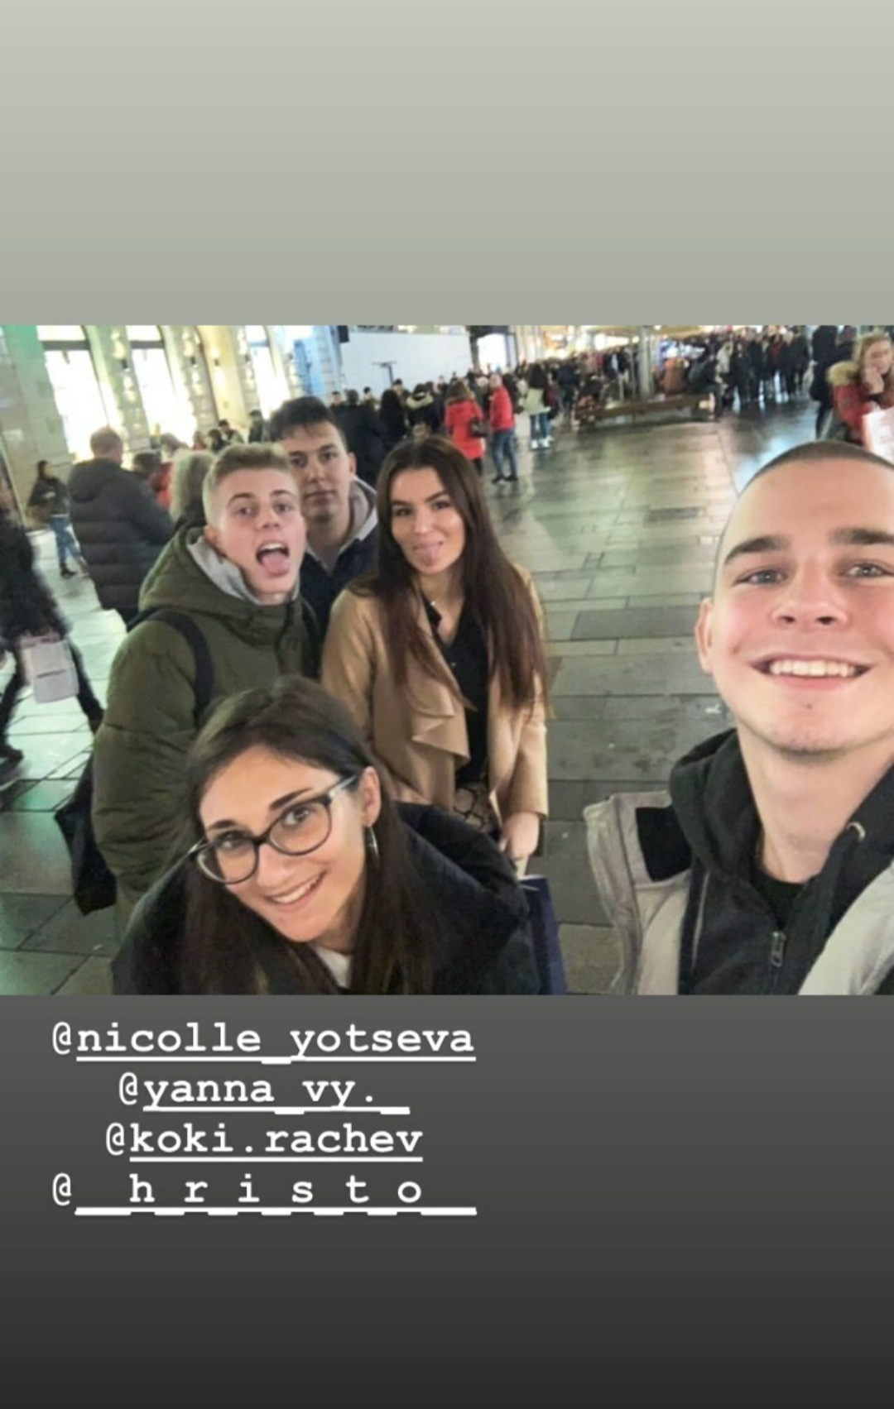
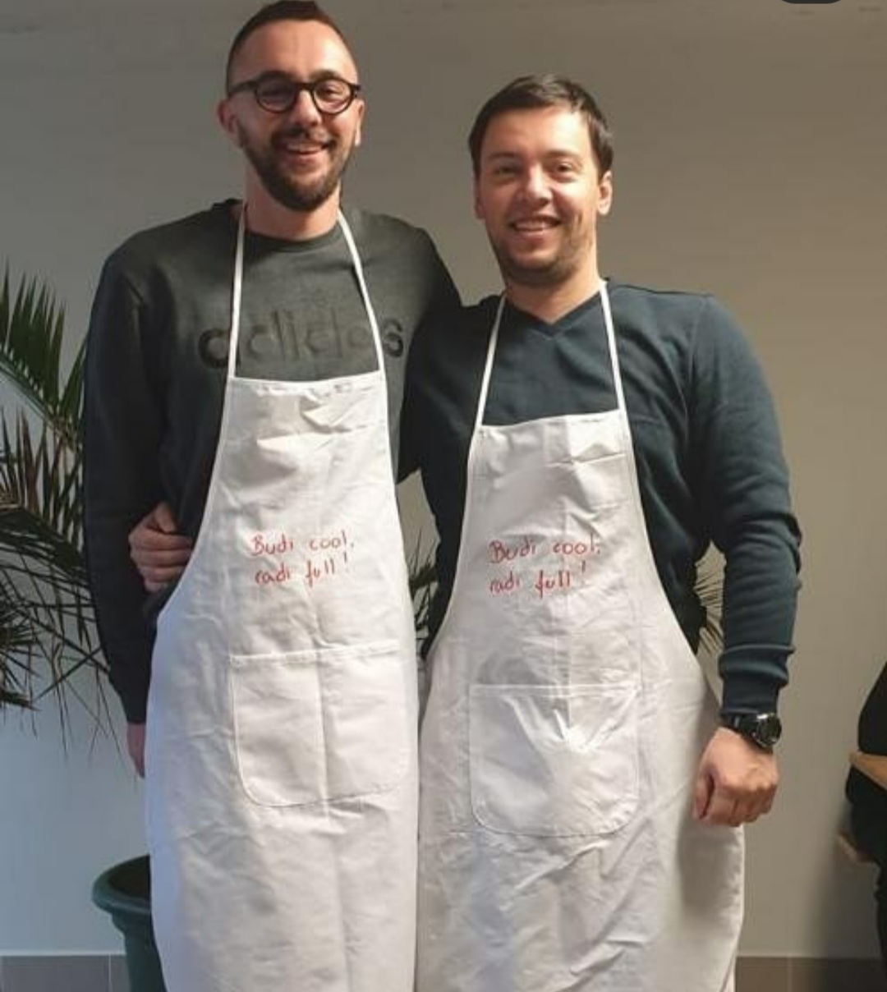
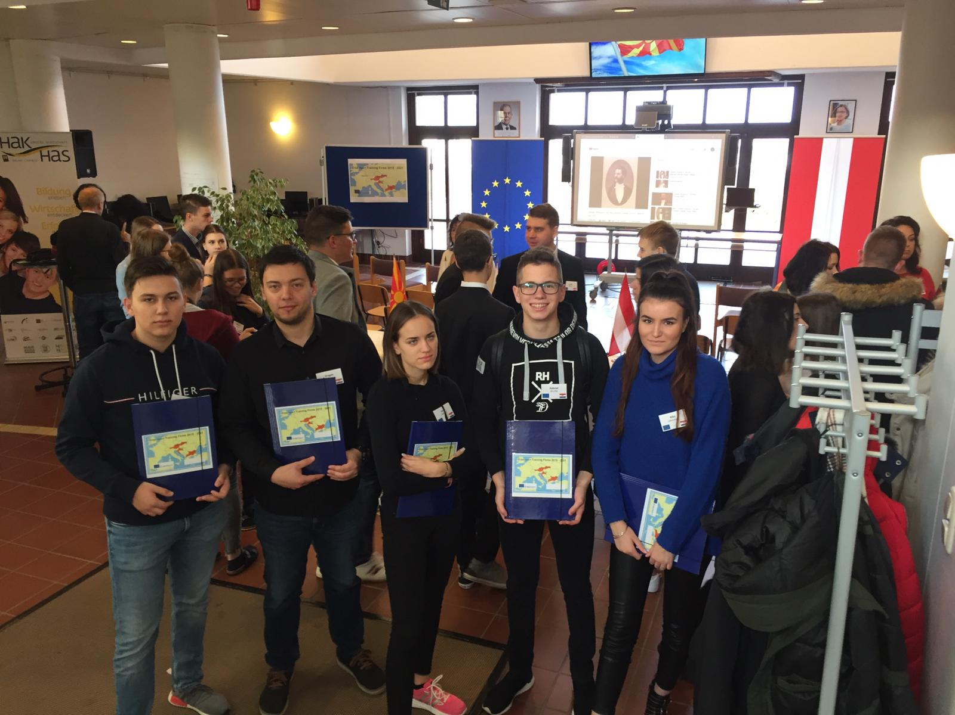
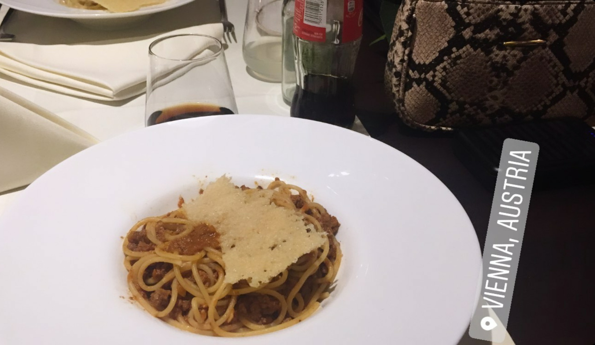
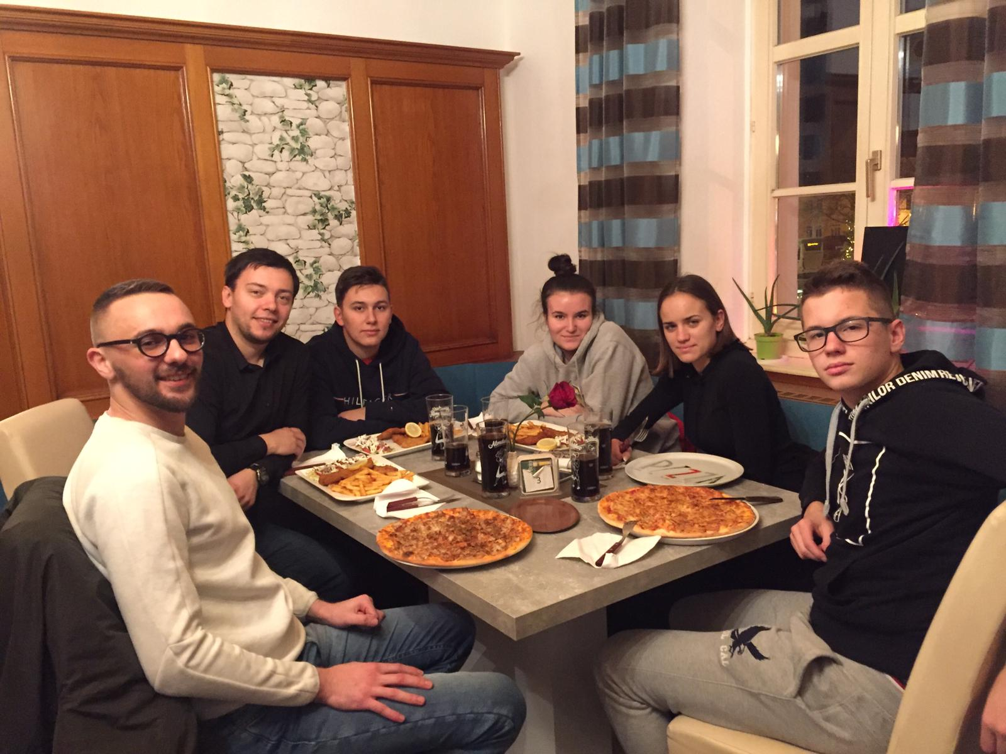
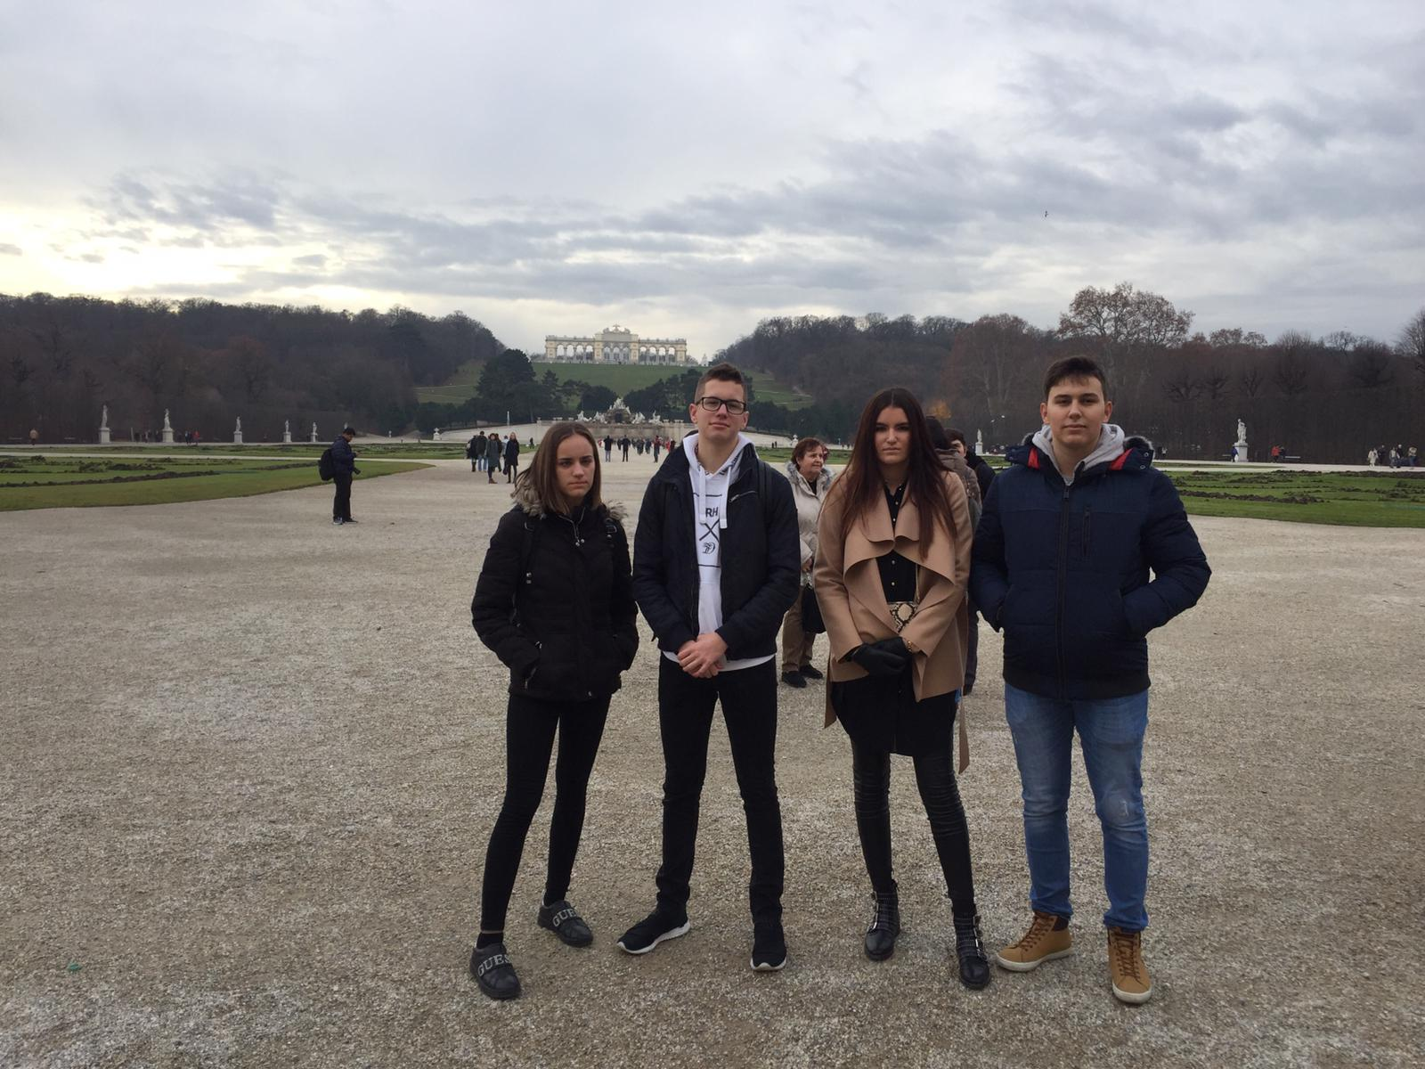
THROWBACK TO LAA AN DER THAYA

Slide 12
Thank you for watching!

