Slide 1
BUSINESS PLAN
ROCK SHOCK

Slide 3
The „ROCK SHOCK“ company is envisaged as a modern catering and sales facility offering a wide selection of hot and cold beverages, teas, coffees, chocolate drinks, freshly squeezed juices, milkshakes as well as fast food and treats.
The company’s goal is to establish a perfect relationship with its clients through a unique offerings and uncostly prices which will counteract the impact of competition.

Slide 4
Located in the center of Tivat, it is easily accessible for the citizens and numerous tourists. The bar of 9m² with four employees, including the owner, is conceived as a kiosk which will provide fast, easy and inexpensive purchase of the products similar to those found in shops. What will make a difference is that the most of these products will not be offered in assortments of other shops, and unlike café bars and restaurants, they will be of a much cheaper price.
The bar is conceived to look like a kiosk and therefore will take up a small space. As for the capacity, the number of people who will occupy the bar at the same time is small but sustainable because the main activity of the bar is the purchase after which the customers would takeaway their consumptions.

Slide 5
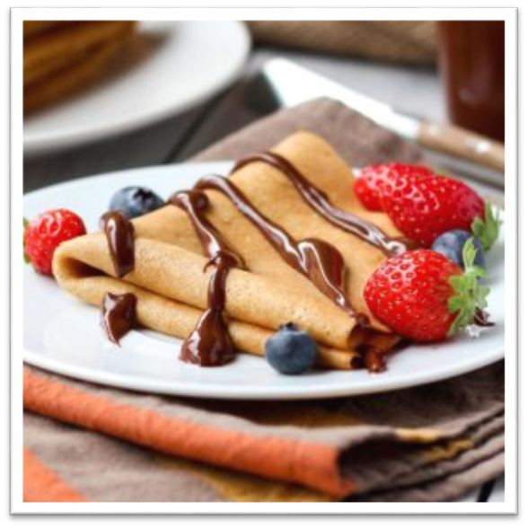
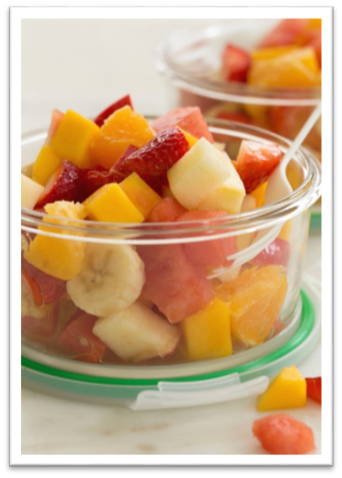
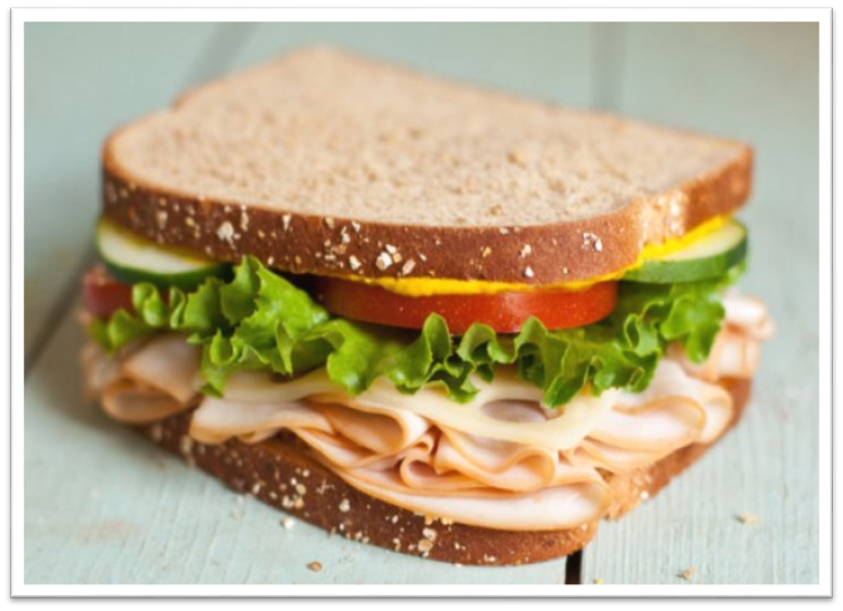

Slide 6
According to the plan, in its first year of doing business, the company will operate with a profit of € 17,500, whereas the planned expenses are slightly more than € 35,000 and planned revenue amounts 52,500 .
The funds will be set aside from equity and partly from a bank loan.
The investment of own financial resources amounts to € 7,000 and other necessary funds will be financed by a bank loan. It is planned that the debit with the bank lasts no longer than 5 years.

Slide 7
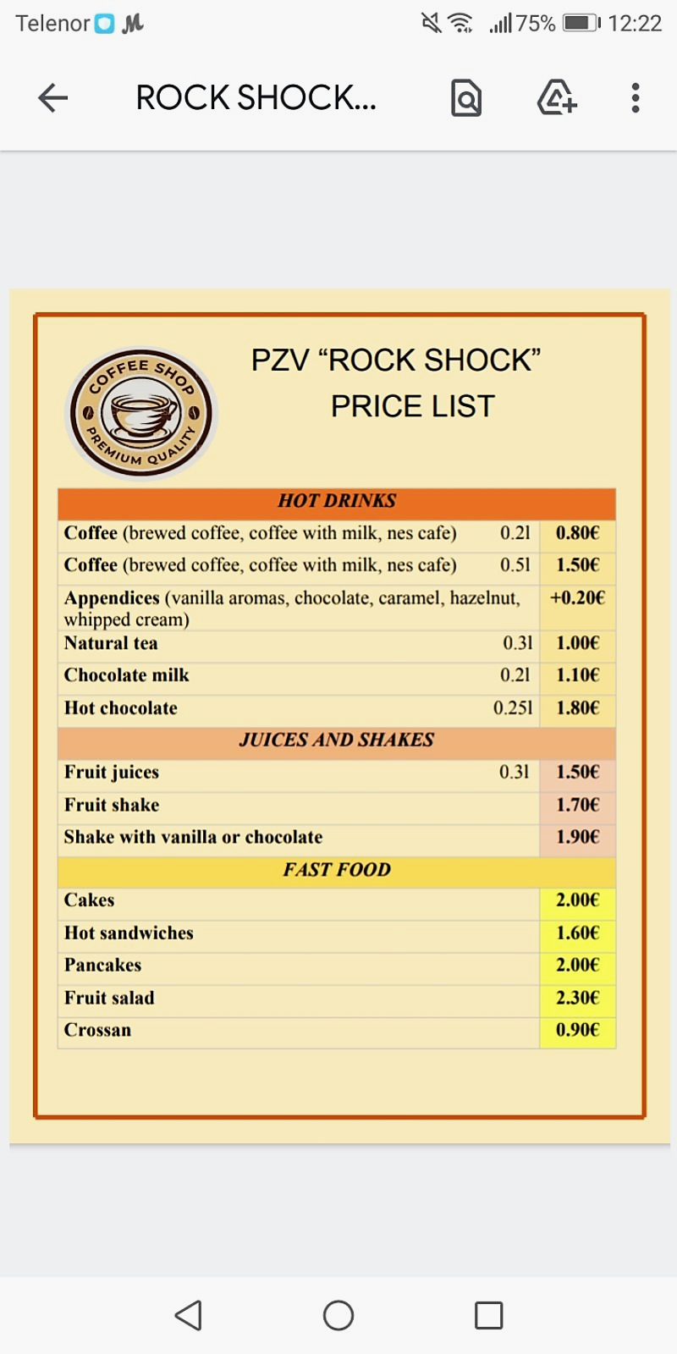
Achieved sales of 90 products per day at an average price of €1.60 per year brings revenue of € 52,500, which is the annual planned revenue.

Slide 8
The aim groups of customers are tourists, employees (people who are busy and do not have time to sit in restaurants or perhaps do not have the money), but our offer is tailored to serve all ages and consumer preferences.
Special emphasis in business will be on speed, helpfulness, kindness and professionalism, which is why “ROCK SHOCK" will stand out from the competition.
The project has been cost-effective and sustainable throughout the observation period, where there the growth and development are being planned along.
The planned time of the necessary works till the moment of the bar opening is 4 months to half a year.

Slide 9
COFFEE TO GO
A WAY TO ALWAYS CARRY A SMILE WITH YOU
-ROCK SHOCK-

