Slide 1
PF “EK racija”
Making decorative objects from recycled materials
Ekonomic and trade school
Pozarevac, Serbia

Slide 2
Who we are?
Student company date of establishment: january 2018.
The main products are made from the newspapers l like baskets, frames, w wall clocks, lamps...
To save the nature don’t throw the paper

Slide 3
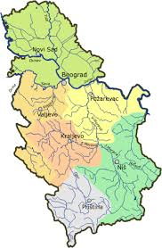
Whеre are we ?
Pozrevac - 80km from capital city Belgrade of Serbia
Pozarevac - the capital of the Branicevo district
Ekonomic and trade schools in P Pozarevac, address: Jovan S Serbanovic 6, Pozarevac

Slide 4
Organizational structure
Managing Director Blagojevic Marko
Assistant Director Bogicevic Veljko
Production
Manager
Jevremovic Dajana
Sales
Manager
Bjeloglav Dusan
Marketing
Manager
Ungurjanovic Milica
Financial
Manager
Milojevic Milena

Slide 5
Sales
Our decorative objects are intendent for both young people and housewives
School and Town
We are selling our products to students and teachers in our school. We participate in shop sale exihibition around the city ond the occasion of holidays, fairs and festivals
Competitions
We are also part of regional, national and international competitions of virtual companies and student companies (Belgrade, Kragujevac, Sokobanja...)
On-line
Via social networks (website, instagram, limundo, internet ads...)

Slide 6
SWOT analysis
STRENGTHS
(+)
Low production costs
Production of products by order
Good price
Original design
Waste reduction
WEAKNESSES
(–)
Insufficient students expirience
High marketing costs
Lack of financial resources
Undeveloped practical skills of students
THREATS
(–)
Experienced women housewives who are doing same or similar job
Deficiency of financial assets
Legal regulations in the country
OPPORTUNITIES
(+)
Wide assortment
Competitive price of product
Creativity and team spirit of our students
Developing ecological awareness
COLORFUL LEAVES SWOT ANALYSIS

Slide 7
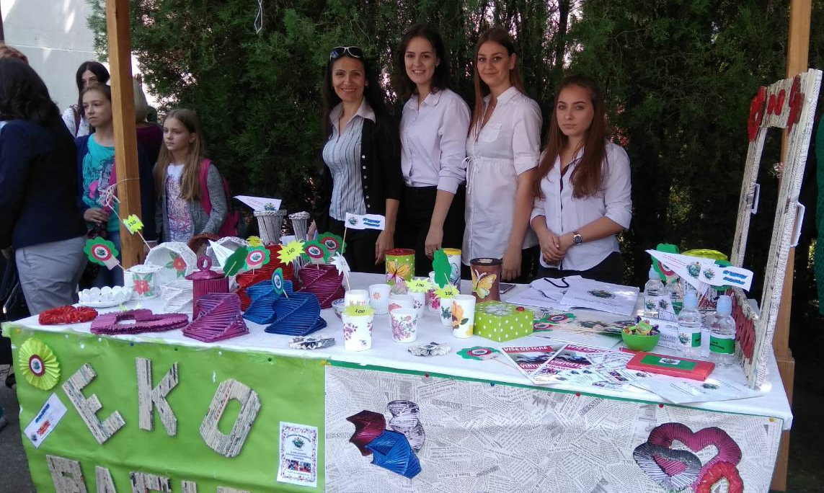
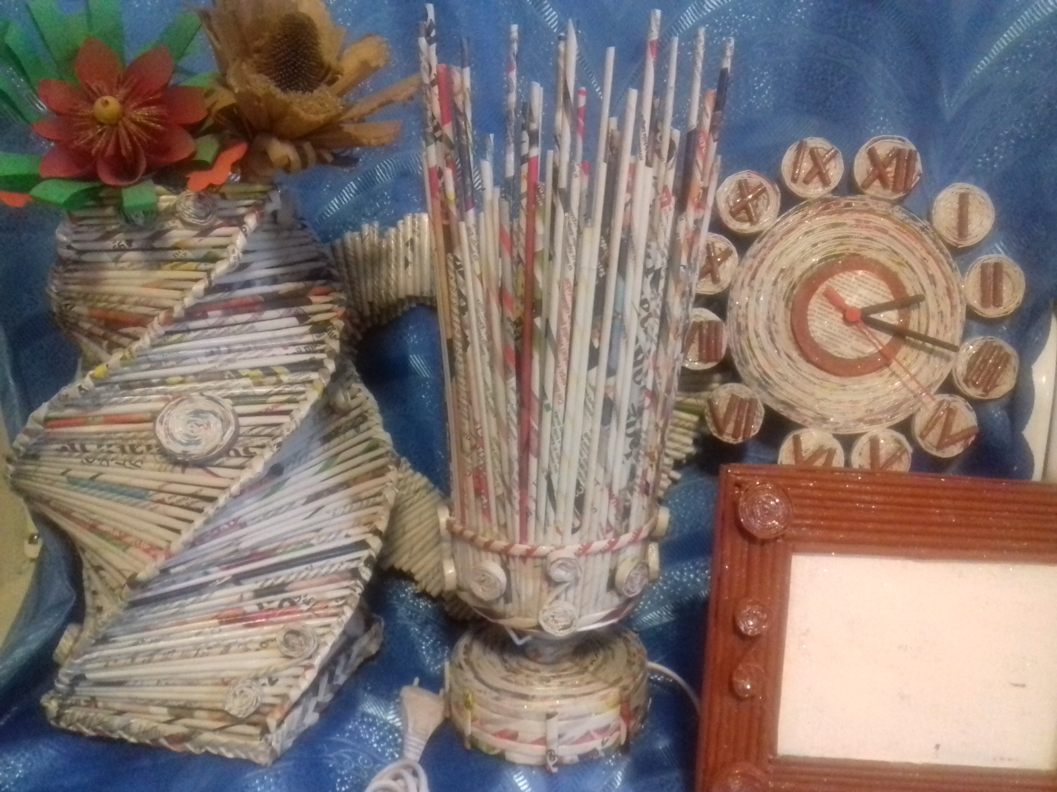
Sales asortment
We have four product lines:
Frame (wall and table)
Clock (wall and table)
Basket (small and large)
Lamp (stone and noon)
For decoration
For a gift
For home use

Slide 8
Promotional plan
Digital marketing:
ekoracija@gmail.com
https://www.ekoracija.weebly.com
uk_ekoracija
Traditional marketing:
Business cards
Brochures & posters
Magnets & flags

Slide 9
Financial plan
CAPITAL STRUCTURE:
Initial capital was collected from the donations of students, their parents and teachers
Later sources of capital are sales exihibitions by school, city and fairs
COSTS:
Procurement costs od lacquer, paint, glue, old lamps and watches
Marketing costs
REVENUES:
From sales
Training of interested people for the manufacturing decorative items

Slide 10
Financial result
 | Sales for a month (ps) | Price per piece (€) | REVENUE for a month | COSTS for a month | PROFIT (€)
BASKETS | 20 | 3,00 | 60,00 | 5,00 | -
FRAMES | 30 | 5,00 | 150,00 | 5,00 | -
WATCHES | 5 | 7,00 | 35,00 | 10,00 | -
LAMPS | 10 | 10,00 | 100,00 | 10,00 | -
TOTAL: | - | - | 345,00 | 30,00 | 315,00

Slide 11
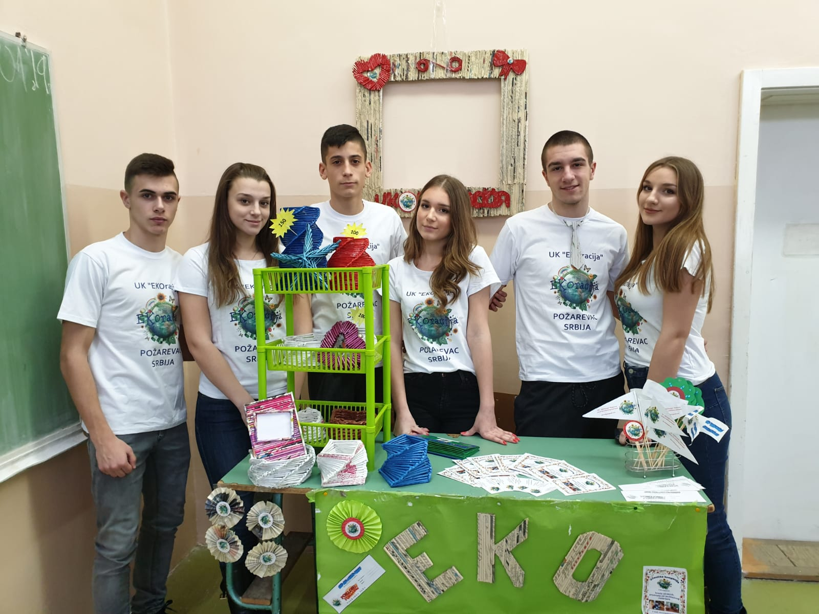
For better nation
chose ECOration!
BIG
image
Thanks!

