Slide 1
ROCK SHOCK
CATALOG
„Coffee to go, a way to always carry a smile with you.“

Slide 2
-ABOUT US-
The company ROCK SHOCK is conceived as a modern catering and sales facility that offers a wide selection of hot and cold drinks, squeezed juices, shakes and fast food and desserts.
The products will be distinguished by the fact that most of them cannot be found in the assortments of stores, and unlike cafes and restaurants, the products will have a much lower price.
Located in the center of Tivat within easy reach of citizens and many tourists.

Slide 3
CAFFEE code: 020
Coffee of various types, brewed coffee, instant coffee, with or without milk ..
Possibility to add whipped cream or aromas of vanilla, chocolate, hazelnuts ..
Small glass (0.2l) 0.80 €
Large glass (0.5l) 1.50 €

Slide 4
NATURAL TEAS code: 025
Natural teas (herbal, fruit) 0.3l 1.00 €

Slide 5
CHOCOLATE DRINKS
Hot chocolate:
code: 030
0.25l - 1.80€
Chocolate milk (hot or cold)
code: 031
0.2l – 1.10€

Slide 6
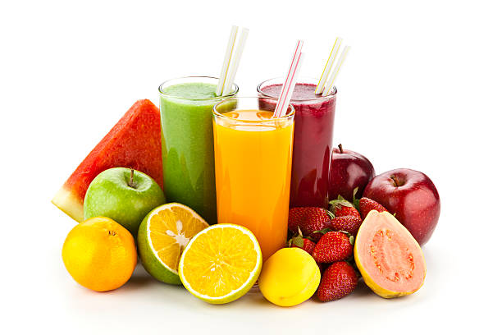
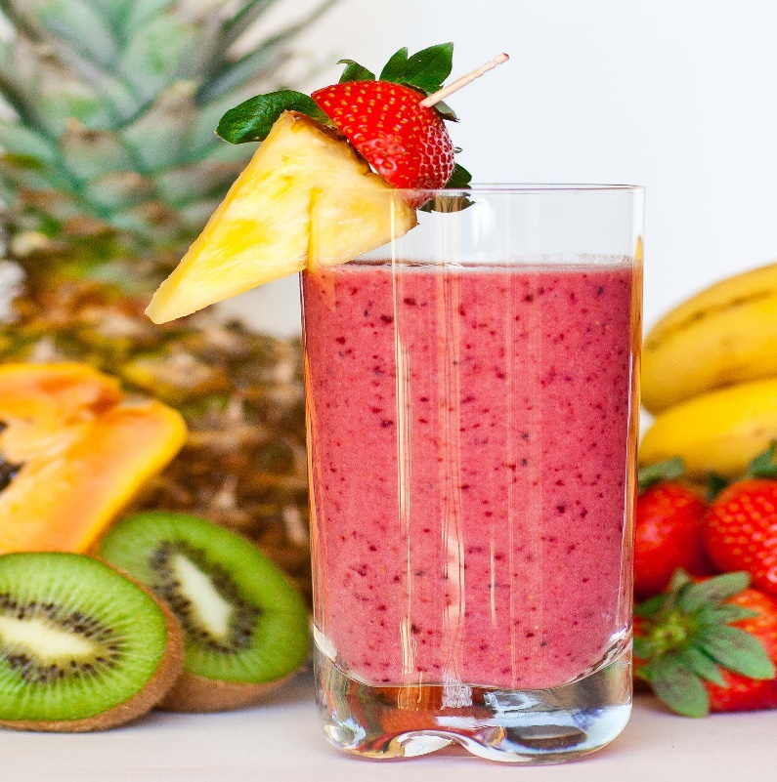
FRUIT JUICES FRUIT SHAKES
Code: 040 code: 042
1.50€ 1.70€

Slide 7
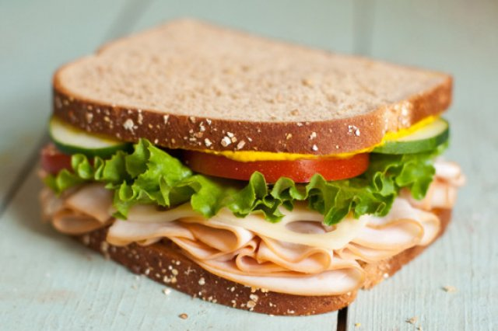
FOOD
code: 053
0.90€
code: 055
1.60€

Slide 8
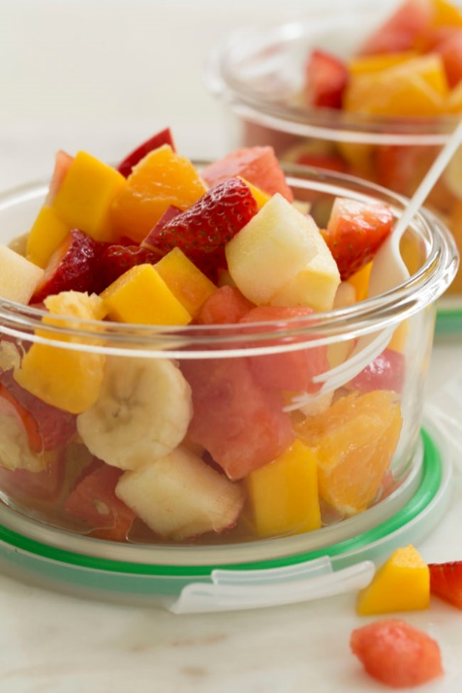
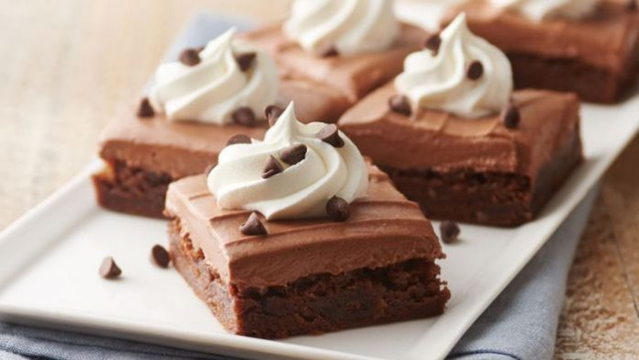
SWEET STUFF & DESSERTS
Pancakes code: 111
2.00€
Fruit salad code: 101
2.30€
Cakes code: 222
2.00€

